Slide 1

EYE-GUIDED CURSOR CONTROL: PRECISION THROUGH VISION
Under the guidance of:
Mrs. P. Oshin
[Asst.Professor]
N. Nishitha, 20P61A6739
P. Yeshwanth, 20P61A6745
M. Suryaprakash Reddy, 20P61A6736

Slide 2
ABSTRACT
This study explores a fascinating approach to computer interaction by utilizing the natural movement of the eyes to control the on-screen cursor. Traditional mouse and keyboard methods may sometimes pose challenges, especially for individuals with physical limitations. The proposed eye-ball-based cursor movement system aims to provide an intuitive and accessible alternative. In this research, we delve into the technology behind eye-tracking devices and their integration into mainstream computing. By understanding how the eyes move, we can create a responsive system that allows users to effortlessly control the cursor with their gaze. The simplicity of this method opens doors to a more inclusive computing experience for everyone. The study investigates the potential applications of eye-ball-based cursor movement, including gaming, accessibility features, and enhanced user interfaces. Moreover, we address concerns related to privacy and user comfort, ensuring that the technology respects individual boundaries. Through this exploration, we aim to contribute to the ongoing efforts in making technology more user-friendly and accessible, ultimately fostering a more inclusive digital environment for people of all abilities.
Keywords:
Eye-tracking, Eye-ball-based interaction, OpenCV, Gaze control, Human-computer interaction

Slide 3
EXISTING SYSTEM
Company like Tobii have made computer systems where you can control the cursor using your eyes. Tobii is known for helping gamers and making technology for people who need assistance. Smart Eye is focused on using eye-tracking in research and different industries. There's even a simple and low-cost option called GazePointer that uses a regular webcam. If you play games on certain Acer laptops, like the Predator series, they have special eye-tracking technology built in. These systems make computers easier to use for everyone by letting you move the cursor with just your eyes.

Slide 4
PROPOSED SYSTEM
The proposed system aims to create an intuitive and accessible way of interacting with computers by using eye movements to control the on-screen cursor. Leveraging eye-tracking technology, the system will track the user's gaze and translate it into precise cursor movements. This method offers a user-friendly alternative for cursor control, particularly beneficial for individuals with physical limitations or those seeking a more natural and responsive interface. The system's simplicity will enhance accessibility, making it easier for a wider range of users to navigate digital environments. Additionally, the research will explore potential applications, such as gaming and user interfaces, while addressing privacy concerns to ensure a secure and comfortable user experience. This innovative approach seeks to contribute to the development of inclusive and user-centric computing systems.

Slide 5
SOFTWARE REQUIREMENTS
PyCharm
VS Code
Python packages

Slide 6
HARDWARE REQUIREMENTS
Processor: i5
Webcam

Slide 7
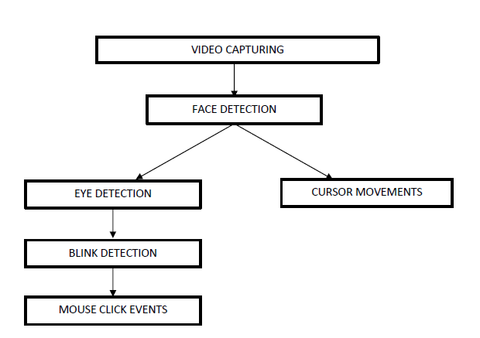
System architecture

Slide 8

OUTPUT
Cursor Movements

Slide 9
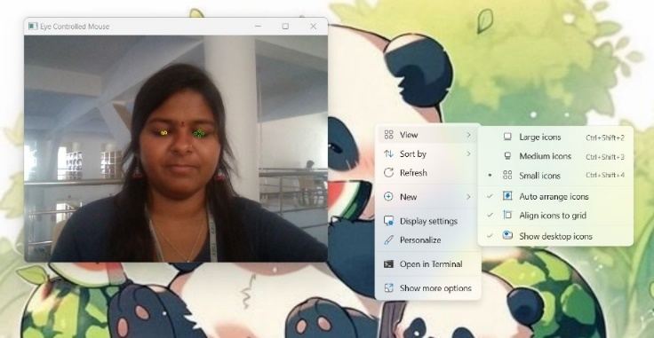
Click Operation

Slide 10
THANK YOU

